Slide 1
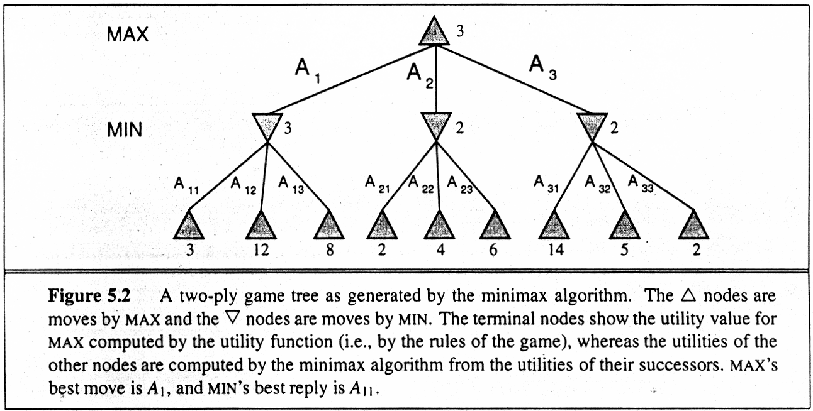
Game Trees

Slide 2
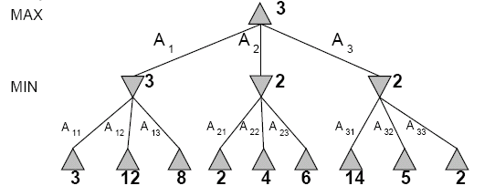
Two-Ply Game Tree

Slide 3
Two-Ply Game Tree

Slide 4
Two-Ply Game Tree
Minimax maximizes the utility for the worst-case outcome for max
The minimax decision

Slide 5
Pseudocode for Minimax Algorithm
function MINIMAX-DECISION(state) returns an action
inputs: state, current state in game
return arg max_{a∈Actions(state)} Min-Value(Result(state,a))
function MAX-VALUE(state) returns a utility value
if TERMINAL-TEST(state) then return UTILITY(state)
v ← −∞
for a in ACTIONS(state) do
v ← MAX(v,MIN-VALUE(Result(state,a)))
return v
function MIN-VALUE(state) returns a utility value
if TERMINAL-TEST(state) then return UTILITY(state)
v ← +∞
for a in ACTIONS(state) do
v ← MIN(v,MAX-VALUE(Result(state,a)))
return v

Slide 6
Properties of minimax
Complete?
Yes (if tree is finite).
Optimal?
Yes (against an optimal opponent). Can it be beaten by an opponent playing sub-optimally?
No. (Why not?)
Time complexity?
O(b^{m})
Space complexity?
O(bm) (depth-first search, generate all actions at once)
O(m) (backtracking search, generate actions one at a time)

Slide 7
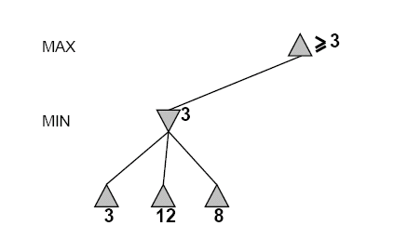
Another Alpha-Beta Example
Do DF-search until first leaf
Range of possible values
(−∞,+∞)
(−∞, +∞)

Slide 8
Alpha-Beta Example (continued)
(−∞,+∞)
(−∞,3]

Slide 9
Alpha-Beta Example (continued)
(−∞,+∞)
(−∞,3]

Slide 10
Alpha-Beta Example (continued)
[3,+∞)
[3,3]

Slide 11
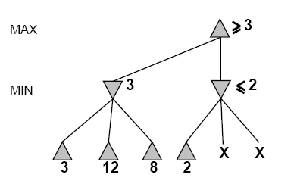
Alpha-Beta Example (continued)
[3,+∞)
This node is
worse for MAX
[3,3]
(−∞,2]

Slide 12
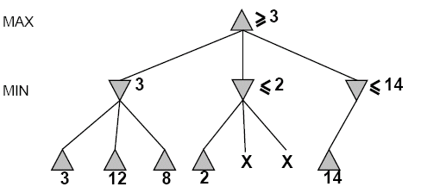
Alpha-Beta Example (continued)
[3,14]
,
[3,3]
(−∞,2]
(−∞,14]

Slide 13
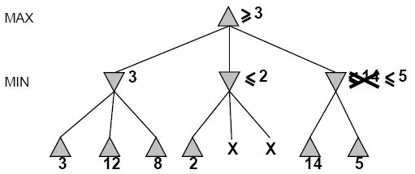

Alpha-Beta Example (continued)
[3,5]
,
[3,3]
(−∞,2]
(−∞,5]

Slide 14
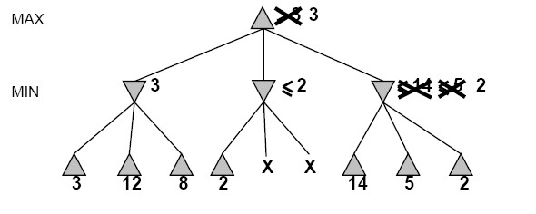
Alpha-Beta Example (continued)
[3,3]
[3,3]
(−∞,2]
[2,2]

Slide 15
Alpha-Beta Example (continued)
[3,3]
[3,3]
(−∞,2]
[2,2]

Slide 16
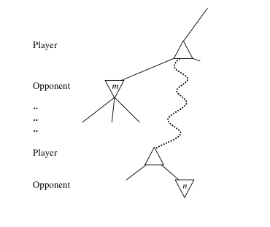
General alpha-beta pruning
Consider a node n in the tree ---
If player has a better choice at:
Parent node of n
Or any choice point further up
Then n will never be reached in play.
Hence, when that much is known about n, it can be pruned.

Slide 17
Alpha-beta Algorithm
Depth first search
only considers nodes along a single path from root at any time
α = highest-value choice found at any choice point of path for MAX
(initially, α = −infinity)
β = lowest-value choice found at any choice point of path for MIN
(initially, β = +infinity)
Pass current values of α and β down to child nodes during search.
Update values of α and β during search:
MAX updates α at MAX nodes
MIN updates β at MIN nodes
Prune remaining branches at a node when α ≥ β

Slide 18
When to Prune
Prune whenever α ≥ β.
Prune below a Max node whose alpha value becomes greater than or equal to the beta value of its ancestors.
Max nodes update alpha based on children’s returned values.
Prune below a Min node whose beta value becomes less than or equal to the alpha value of its ancestors.
Min nodes update beta based on children’s returned values.

Slide 19
Pseudocode for Alpha-Beta Algorithm
function ALPHA-BETA-SEARCH(state) returns an action
inputs: state, current state in game
v←MAX-VALUE(state, - ∞ , +∞)
return the action in SUCCESSORS(state) with value v

Slide 20
Pseudocode for Alpha-Beta Algorithm
function ALPHA-BETA-SEARCH(state) returns an action
inputs: state, current state in game
v←MAX-VALUE(state, - ∞ , +∞)
return the action in ACTIONS(state) with value v
function MAX-VALUE(state,α , β) returns a utility value
if TERMINAL-TEST(state) then return UTILITY(state)
v ← - ∞
for a in ACTIONS(state) do
v ← MAX(v,MIN-VALUE(Result(s,a), α , β))
if v ≥ β then return v
α ← MAX(α ,v)
return v
(MIN-VALUE is defined analogously)

Slide 21
Alpha-Beta Example Revisited
Do DF-search until first leaf
α, β, initial values
α=−∞
β =+∞
α, β, passed to kids
α=−∞
β =+∞

Slide 22
Alpha-Beta Example (continued)
α=−∞
β =+∞
α=−∞
β =3
MIN updates β, based on kids

Slide 23
Alpha-Beta Example (continued)
α=−∞
β =+∞
α=−∞
β =3
MIN updates β, based on kids.
No change.

Slide 24
Alpha-Beta Example (continued)
MAX updates α, based on kids.
α=3
β =+∞
3 is returned
as node value.

Slide 25
Alpha-Beta Example (continued)
α=3
β =+∞
α, β, passed to kids
α=3
β =+∞

Slide 26
Alpha-Beta Example (continued)
α=3
β =+∞
MIN updates β,
based on kids.
α=3
β =2

Slide 27
Alpha-Beta Example (continued)
α=3
β =+∞
α=3
β =2
α ≥ β,
so prune.

Slide 28
Alpha-Beta Example (continued)
MAX updates α, based on kids.
No change.
α=3
β =+∞
2 is returned
as node value.

Slide 29
Alpha-Beta Example (continued)
α=3
β =+∞
,
α, β, passed to kids
α=3
β =+∞

Slide 30
Alpha-Beta Example (continued)
α=3
β =+∞
,
MIN updates β,
based on kids.
α=3
β =14

Slide 31
Alpha-Beta Example (continued)
α=3
β =+∞
,
MIN updates β,
based on kids.
α=3
β =5

Slide 32
Alpha-Beta Example (continued)
α=3
β =+∞
2 is returned
as node value.
2

Slide 33
Alpha-Beta Example (continued)
Max calculates the same node value, and makes the same move!
2

Slide 34
Answer to Example
-which nodes can be pruned?
Max
Min
Max
5
6
3
4
1
2
7
8
Answer: NONE! Because the most favorable nodes for both are explored last (i.e., in the diagram, are on the right-hand side).

Slide 35
Second Example (the exact mirror image of the first example)
-which nodes can be pruned?
3
4
6
5
8
7
2
1

Slide 36
Answer to Second Example (the exact mirror image of the first example)
-which nodes can be pruned?
Max
Min
Max
3
4
6
5
8
7
2
1
Answer: LOTS! Because the most favorable nodes for both are explored first (i.e., in the diagram, are on the left-hand side).

